Slide 1
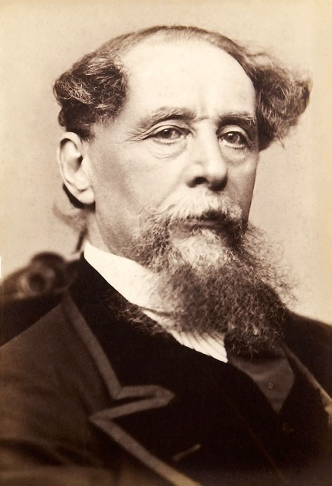
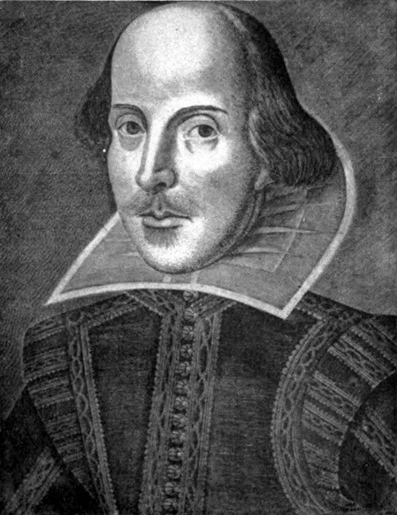
Preparing for English Literature Unit 1
Mrs Demetriou
just
LOVES
C.D and W.S!!!
WALT: Understand how to approach Unit One Literature SO THAT we can achieve highly in our exams.

Slide 2
About – 50 minutes per question.
10 mins planning.
40 minutes writing.

Slide 3
Great Expectations – the plot
https://www.youtube.com/watch?v=mJsyzUgKGwY
http://www.bbc.co.uk/education/guides/zsybr82/video

Slide 4
Part 1
Pip is an orphan living on the Kent marshes with his abusive sister and her husband, Joe Gargery, the village blacksmith. While exploring in the churchyard near the tombstones of his parents, Pip is accosted by an escaped convict. The convict scares Pip into stealing food for him, as well as a metal file to saw off the convict's leg iron. Returning with these the next morning, Pip discovers a second escaped convict, an enemy of the first one. Shortly afterward, both convicts are recaptured while fighting each other.
Pip's pompous Uncle Pumblechook arranges for Pip to go to the house of a wealthy reclusive woman, Miss Havisham, to play with her adopted daughter, Estella. The house is a strange nightmare-world. Miss Havisham's fiancé jilted her on her wedding day and she still wears her old wedding gown, although she's now elderly and wheel-chair-bound. The house has been left as it was on her wedding day and even the old wedding cake is still on the table. Estella is beautiful but haughty and tells Pip that he is coarse and common. Pip is immediately attracted to Estella in spite of how she and Miss Havisham treat him. Although the visits are emotionally painful and demeaning, Pip continues to go there for several months to play with Estella and to wheel Miss Havisham around. He also meets her toady relatives who want her money and hate Pip. Pip does earn a kiss from Estella when he beats one of the relatives, the Pale Young Gentleman, in a fistfight. Pip tries to better himself to win Estella's admiration by working harder with his friend, Biddy, at night school. Biddy's grandmother runs the night school.

Slide 5
Part 1 continued
After a number of months, Miss Havisham pays for Pip's blacksmithing apprenticeship with Joe. Pip had looked forward to that for years, but now that he has seen "genteel" life, he views the forge as a death sentence. However, he hides his feelings from Joe and performs his duties. During this time, he encounters a strange man at the Jolly Bargemen, a local pub. The man has the file that Pip stole for the convict years before. The man gives Pip two one-pound notes. Pip continues to visit Miss Havisham on his birthday and on one of these occasions, his leaving work early instigates a fistfight between Joe and Joe's assistant, Dolge Orlick. Orlick resents Pip and hates Pip's abusive sister. On his way home from that visit, Pip finds out his sister was almost murdered and is now mentally crippled. Biddy comes to live with them to help out. Pip is attracted to her even though she is not educated and polished like Estella.
One evening, a powerful London lawyer, Mr. Jaggers, visits Pip and Joe and informs them that Pip has "great expectations." Pip is overjoyed and assumes the windfall is from Miss Havisham, who wants to prepare him for Estella. He gets a new suit of clothes and is amazed at how differently he is treated by Mr. Trabb, the tailor, and by Uncle Pumblechook. When Pip gets Trabb's shop boy in trouble for not treating Pip with respect, he realizes how money changes things. He has a conversation with Biddy and asks her to work on "improving" Joe. Pip accuses her of being jealous of him when she suggests Joe does not need improving. By the end of the week, Pip is on his way to London to become a gentleman.

Slide 6
Part 2
In London, Pip meets with Jaggers and his clerk, Mr. Wemmick. Wemmick brings Pip to the apartment of Herbert Pocket, who, Pip discovers, is the Pale Young Gentleman he fought at Miss Havisham's. Pip is to study with Herbert's father, Mr. Matthew Pocket, to learn how to be a gentleman. Pip and Herbert become good friends and Herbert nicknames Pip, Handel. Pip spends part of his time with Herbert and part of his time with the Pocket family. Also living at the Pocket's family home are two other "gentlemen students," Startop and Bentley Drummle. Drummle and Pip do not get along, especially later, when Drummle becomes involved with Estella.
Pip is embarrassed when Joe visits him in London with a message from Miss Havisham and cannot wait for Joe to leave. When Pip returns home to see Miss Havisham, he avoids Joe's forge. Miss Havisham informs Pip he is to accompany Estella to London where she will live with a wealthy society woman. Pip is convinced Miss Havisham intends Estella for him. In London, he spends his time visiting with Estella, spending too much money with Herbert, and joining a group of useless rich men called the Finches. He also makes friends with Jaggers' clerk, Wemmick, and realizes that the stiff legal clerk has a different, kinder personality at home. Pip also realizes that he is harming Herbert financially with their debts, and with Wemmick's help, secretly arranges to set Herbert up in business with a merchant named Clarriker. During this time, Pip's sister dies. He returns for her funeral and is remorseful over his abandonment of Joe and Biddy. He promises he will visit more often and is angry when Biddy implies that she does not believe him.

Slide 7
Part 2 continued
On a stormy evening back in London, Pip's world changes dramatically with the arrival of a ragged stranger whom Pip realizes is the convict from the marshes years ago. The convict, whose name is Magwitch, had been sent to Australia and was to never return to England under penalty of death. The convict made a fortune in Australia and has risked death to return and tell Pip that he is the source of Pip's expectations. Pip is disgusted and devastated, something Magwitch, in his happiness to see his "gentleman," does not notice. Pip now knows that Miss Havisham has not been preparing him for Estella, and that with his money coming from a convict he can never have Estella. He also realizes he deserted Joe for a convict's money.

Slide 8
Part 3
Magwitch explains to Pip that he has come to give him his full inheritance as thanks for his help on the marshes years before. He tells Pip about the other convict, a man named Compeyson. Pip later learns from Herbert that Compeyson was the same man who broke Miss Havisham's heart. Pip decides he will take no more of Magwitch's money. However, he feels responsible for the danger the man is in and will find a way to get him safely out of the country.
Pip is crushed to hear that Bentley Drummle is to marry Estella. Pip visits with her and Miss Havisham and pleads with her not to do this. He professes his deep love, which she cannot fathom, and tells her that he would be happy if she married another as long as it was not Drummle. During this conversation, Estella and Miss Havisham have an argument that shows she cannot love Miss Havisham, either. Miss Havisham realizes the depth of the damage she has done and is heartbroken.
Returning to London, Pip learns from Wemmick that Compeyson is watching Magwitch. Herbert and Pip hide Magwitch and devise an escape plan. Pip also gets an anonymous note to come to the marshes where someone has information about Magwitch. He returns home and visits Miss Havisham before going to the marshes. She begs his forgiveness and agrees to Pip's request to help fund Herbert Pocket's new business. Pip starts to leave then returns to see Miss Havisham's dress on fire. He saves her but she is very ill afterward. He goes to the marshes, where he is captured by Orlick, who intends to kill him. Rescue comes from Herbert and Startop who had followed him from London. Trabb's shop boy led them to the marshes.
They return to London and carry out their escape plan with Magwitch, but Compeyson has informed the authorities and they are caught. Compeyson and Magwitch struggle and fall into the river. Compeyson drowns and Magwitch is hurt, then imprisoned and sentenced to die. Pip by now has figured out Magwitch is Estella's father. He visits and cares for Magwitch until the man dies in prison. Afterward, Pip attends Wemmick's wedding. Pip also gets very sick and is himself arrested for not paying his debts. Joe comes and nurses Pip back to health and tells him Miss Havisham has died, leaving a large amount of money to Mr. Matthew Pocket. Before returning to his forge, Joe also pays off Pip's debt. Pip goes home, intending to make amends with Joe and marry Biddy. He arrives just in time to celebrate Joe and Biddy's wedding. Pip leaves shortly afterward for eleven years in Cairo, working with Herbert in his business. When he returns, he visits with Joe and Biddy and meets their son, little Pip. He also meets with Estella. She is a widow now after years in an abusive marriage to Drummle. She and Pip part, but the implication is that this time they will be together.

Slide 9
Test yourself
http://www.bbc.co.uk/education/guides/zsybr82/test

Slide 10
Social context – class
http://www.bbc.co.uk/education/guides/zy3r4wx/revision/4
Victorian society – dominated by class
To succeed in society you had to know the rules
Your class would determine the life that you would have
Having good manners, such as table manners, were important and helped to prove that you were part of the “middle class”
Middle and upper class people were expected to use Standard English without a regional accent
Industrial Revolution – it became easier for people to get rich by investing in industry. People could earn their wealth but were still seen as “lower” or less acceptable than people who had inherited their wealth.
Being classed as a “gentleman” was seen as a good thing
A gentleman would be based on social class or job
Some people found that you could be a gentleman by being kind and having strong morals – however this was not always accepted as this was not respected by the rich upper classes

Slide 11
Preparing for English Literature Unit 1 Lesson 2
Mrs Demetriou
just
LOVES
C.D and W.S!!!
WALT: Understand how to approach Unit One Literature SO THAT we can achieve highly in our exams.

Slide 12
Walk around the room – find someone that you don’t normally work with
In pairs, you are going to list all of the key events in “Great Expectations” without repeating any.
Who can be the last ones standing?

Slide 13
Question (exactly the same as R and J):
It will tell you WHERE from the novel it is and what is happening.
E.g.
This is taken from the start of the novel when Pip is introducing himself.
Then it will print out the extract
Then it will ask you a question that you need to look at the extract for and the whole novel.
For example:
Starting with this extract, how does Dickens present the character of Pip?
Write about:
How Dickens writes about Pip in this extract
How Dickens writes about Pip in the novel as a whole

Slide 14
How would Mrs Demetriou approach this?
Think carefully about this, why important?
I would highlight the key words in the question:
This is taken from the start of the novel when Pip is introducing himself.
Starting with this extract, how does Dickens present the character of Pip?
Write about:
How Dickens writes about Pip in this extract
How Dickens writes about Pip in the novel as a whole
Ok, this seems important – so
I will use the extract first
How is repeated many times – this is crucial. It means language.

Slide 15
Then, I would have a quick think about how marks are awarded…
30 marks
A01 – ideas (points)
A02 – language features
A03 – Context

Slide 16
Next, I would annotate the extract. Let’s do this together.
My father's family name being Pirrip, and my Christian name Philip, my infant tongue could make of both names nothing longer or more explicit than Pip. So, I called myself Pip, and came to be called Pip.
I give Pirrip as my father's family name, on the authority of his tombstone and my sister - Mrs. Joe Gargery, who married the blacksmith. As I never saw my father or my mother, and never saw any likeness of either of them (for their days were long before the days of photographs), my first fancies regarding what they were like, were unreasonably derived from their tombstones. The shape of the letters on my father's, gave me an odd idea that he was a square, stout, dark man, with curly black hair. From the character and turn of the inscription, "Also Georgiana Wife of the Above," I drew a childish conclusion that my mother was freckled and sickly. To five little stone lozenges, each about a foot and a half long, which were arranged in a neat row beside their grave, and were sacred to the memory of five little brothers of mine - who gave up trying to get a living, exceedingly early in that universal struggle - I am indebted for a belief I religiously entertained that they had all been born on their backs with their hands in their trousers-pockets, and had never taken them out in this state of existence.

Slide 17
Then:
I would start my response by writing about 5 key points from the extract
I would then complete it by giving 5 key points form the rest of the novel
I would plan all of this before I started to write
Let’s do this together.

Slide 18
Preparing for English Literature Unit 1 Lesson 3
Mrs Demetriou
just
LOVES
C.D and W.S!!!
WALT: Understand how to approach Unit One Literature SO THAT we can achieve highly in our exams.

Slide 19
Groups of 4. Give yourself a number.
1 – Romeo
2 –Juliet
3- Lord Capulet
4- Tybalt
Write a tricky question and answer on to a piece of paper. We will be trading these in a moment!

Slide 20
Let’s think about love – let’s face it. It’s going to be in a R and J question somewhere!
http://www.bbc.co.uk/education/guides/zg6psbk/revision/2
What types of love can you think of
in Romeo and Juliet?

Slide 21
Social and historical context
What factors can you think of? How to they influence the characters?

